Slide 1
Explainable Models for Epidemiological Forecasting
- Aryan Pariani, Shayar Shah, Aravind Vengarai
Final Project Presentation for CSE 8803 EPI – Fall 2023

Slide 2
Introduction
Complex Modeling Challenge:
Increasing reliance on sophisticated deep learning and statistical models for epidemiological forecasting
Complexity and opaqueness of these models obscure the understanding of influential factors
COVID-19 Context:
The COVID-19 pandemic has accentuated the need for accurate epidemic forecasting
Issue with Interpretability:
Difficulty in deciphering the rationale behind model predictions
Lack of transparency hinders effective early detection and response planning

Slide 3
Importance
Impact on Decision-Making:
Essential for informed decision-making by governments and health organizations
Critical for planning preemptive actions during key phases of a pandemic
Targeted Policy-Making and Interventions:
Enables the extraction of key features for early signal detection
Supports the design of targeted and effective public health policies and interventions
Broader Implications:
Understanding model predictions is crucial for managing large-scale epidemics
Enhances public trust and transparency in health-related data and forecasting models.

Slide 4
Solution / Problem Formulation
Multivariate Time-Series Forecasting:
Apply VAR and LSTM models for forecasting future COVID-19 case counts in 4 countries: Japan, USA, France, and Italy
Global Explainability Analysis:
Use correlation to identify and rank predictive features for the forecasts for the entire 3-year period of the pandemic (“global”) from Jan 2020 to December 2022.
Local/Phased Explainability Analysis:
Analyze predictive features during short, country-specific pandemic phases (“local”) of notable importance, particularly the Omicron outbreak, using SHAP values.
Cross-Regional and Cross-Phase Analysis:
Compare and understand feature contributions and their variations across different countries and across different pandemic phases in USA.

Slide 5
DATASET – Collection + Processing + Analysis

Slide 6
Data Collection, Pre-Processing and Cleaning
Source: Our main dataset comes from "Our World in Data" (OWID), covering the COVID-19 pandemic from January 2020 to September 2023. It includes data on cases, testing, vaccination, policy responses, and demographics.
Features & Description: The OWID dataset is comprehensive with 67 feature columns, including epidemiological data (confirmed cases, ICU admissions, reproduction rate), testing data (total tests, new tests, positivity rates), vaccination metrics (doses administered, individuals vaccinated), policy responses (school closures, travel restrictions), and demographic data (population, median age, GDP per capita).
Data preprocessing & cleaning: Data from 2020-2022 was used, with missing values imputed with zeroes, with no significant skew in distribution post-imputation. A missing value analysis showed the top five features with the most missing values.

Slide 7
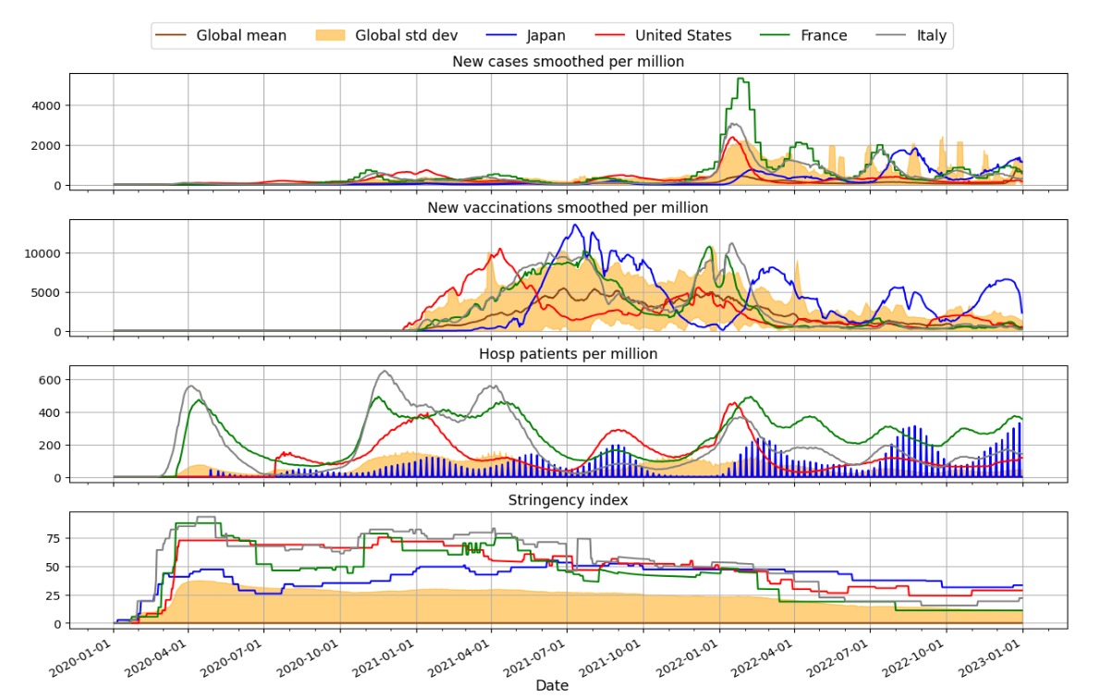
Initial Data Analysis and Hypothesis
Analysis of Country Case Distribution: Focused on four countries (Japan, USA, France, Italy) with high case counts, low fractions of imputed data, and span diverse geographical regions.
Initial Hypothesis: Suspected correlation between case counts and other features, with specific time periods showing high spikes in new case counts.
Figure 1: Time-series plots showing the correlation of various factors with daily new case counts for the four countries.
Figure 1: Comparative analysis of COVID-19 time-series data of daily new case count, daily new vaccination count, number of
hospital patients, and government response stringency across the four chosen countries - "JPN", "USA", "FRA", "ITA"

Slide 8
Inferences from Initial Data Analysis
Correlation Insights: Visual analysis suggests a correlation between rising case counts and other factors like vaccinations, hospital admissions and stringency index during certain periods.
Predictive Feature Set: Hypothesize that these features might be crucial for forecasting case counts.
Notable Periods for Analysis: Early 2022 (Omicron onset), late 2020 (pre-vaccine phase), and declining phase in 2022

Slide 9
METHODOLOGY

Slide 10
Forecasting Approaches
Roll-forward Validation: To predict future COVID-19 case trends, we use a rolling-window or roll-forward validation method. This means we start with a fixed-size temporal subset of training set and validate predictions on next time step, dropping the least recent datapoint and adding the datapoint for the new time step as we move forward. This approach avoids “look-ahead” bias / peeking into the future
Target Variable: For every country, we focus on forecasting "new_cases_smoothed_per_million", representing daily new confirmed COVID-19 cases per million people in the population, smoothed over 7 days
Key Features: To enhance our multivariate forecast's accuracy, we include seven crucial time-series features that can potentially be predictive of case count forecast:
ICU patients per million
COVID-19 reproduction rate
Hospital patients per million
Daily new people vaccinated (smoothed per hundred)
New vaccinations (smoothed per million)
Government response stringency index
Tests per confirmed (positive) case (smoothed)

Slide 11
Forecasting Model Selection and Details
Vector Autoregression (VAR) :
A statistical model capturing linear relationships between multiple time series.
Involves ensuring stationarity (using Augmented Dickey-Fuller test), selecting the lag order, estimating the model, and forecasting future values.
Long Short-Term Memory (LSTM) :
Type of recurrent neural network (deep learning) adept at handling long sequences.
Process includes normalizing data, transforming into valid format (use last 'n' time steps (days) to predict next time step), designing and training LSTM, and forecasting.
Performance Metrics:
Mean Absolute Error (MAE) + Root Mean Square Error (RMSE) to evaluate model accuracy (and reliability for feature explainability analysis)
Bayesian Optimization:
Used for hyperparameter (e.g. learning rate, architecture) tuning to optimize model
Data Splitting:
Temporal split of the dataset over entire 3-year period into 80%-20% split of training / in-sample and testing / out-of-sample sets to assess performance.

Slide 12
Predictive Feature Explainability Analysis
 | Global Analysis | Local / Phased Analysis | Cross-Phase Analysis*
Countries | All 4 (USA, ITA, JPN, FRA) | All 4 (USA, ITA, JPN, FRA) | USA only
Time Period | Entire 3-year period (Jan 2020 – Dec 2022) | One country-specific 21-day phase of fastest case count growth (Omicron outbreak onset (2022)) | Three 21-day phases: 1. fastest growth pre-vaccines (2020) 2. fastest growth (Omicron onset) 3. fastest decline
Metric | PCC – Pearson’s Correlation Coefficient | SHAP (SHapley Additive exPlanations) values | SHAP (SHapley Additive exPlanations) values
Model (s) | VAR + LSTM | LSTM only | LSTM only
*Our Cross-Phase Analysis is a specialized extension of local analysis across multiple “local” phases of importance, but limited only to USA

Slide 13
Predictive Feature Explainability Analysis
Pearson Correlation Coefficient (PCC):
Measures the linear relationship between feature value and case forecast
Ranges from -1 to 1, indicating the strength and direction (positive / negative) of the relationship.
Helps identify features that strongly correlate with COVID-19 case counts.
SHAP (SHapley Additive exPlanations) Values:
Provide a unified measure of feature importance in machine learning models.
Decompose a model's prediction into contributions from each feature.
Allow for visualizing the impact of feature values on predictions, with positive SHAP values contributing to an increase and negative SHAP values contributing to a decrease in the forecasted case counts

Slide 14
RESULTS & DISCUSSION

Slide 15
Multivariate Time-Series Forecasting
Models Used: Employed Vector Autoregression (VAR) and Long Short-Term Memory (LSTM) networks for forecasting new_cases_smoothed_per_million.
Data Preparation and Model Configuration:
Data Split: 80%-20% train-test split, maintaining temporal order to avoid look-ahead bias.
Scaling: MinMax scaling for data normalization, crucial for effective modeling in both VAR and LSTM.
VAR Model Insights: Lag Order Selection: Determined using Akaike Information Criterion (AIC) to balance model complexity and fit.
LSTM Model Insights:
Historical Window: 20-day window to capture short-term temporal dependencies.
Model Architecture: LSTM layer with 128 nodes, two fully connected layers (64 and 32 nodes), and a final output layer.
Training Parameters: Trained for 100 epochs, batch size of 8, using MAE as the loss function, and Adam optimizer.

Slide 16
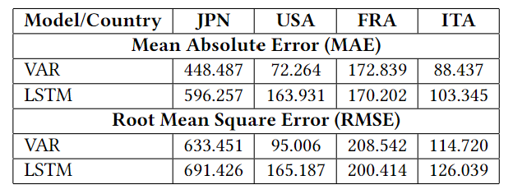
Forecasting Model Performance
Evaluation Metrics: Performance evaluated using Mean Absolute Error (MAE) and Root Mean Squared Error (RMSE).
Results:
Table 1: Testing Error Metric Results (MAE and RMSE) for VAR and LSTM Models across Japan (JPN), USA, France (FRA), and Italy (ITA).
Highlight key findings: Both models showed robust and satisfactory performance, with specific metrics detailed in the table.
Table 1: Testing Error Metric Results - MAE and RMSE – for VAR and LSTM Models for all countries

Slide 17
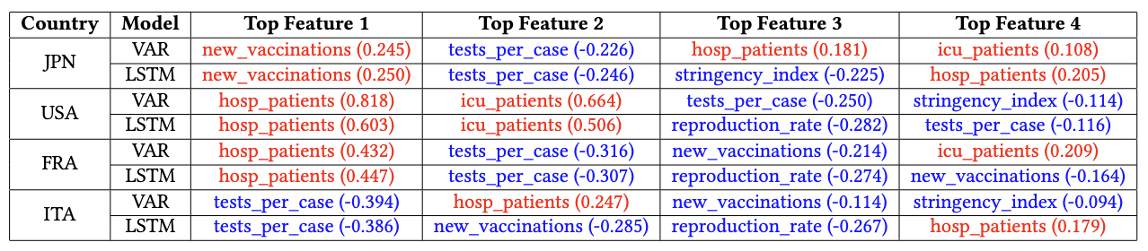
Global Explainability Analysis – Results
Top 4 most predictive features based on Pearson Correlation Coefficient (PCC) of features with LSTM and VAR forecasts for every country (sorted in decreasing order of absolute PCC - red = positive PCC, blue = negative PCC)

Slide 18
Global Explainability Analysis - Discussion (Country-Specific Insights)
Japan (JPN): Counterintuitive positive correlation of new vaccinations with case counts, possibly due to the late surge of COVID-19 cases in JPN during the Omicron variant outbreak + aggressive vaccination campaigns (but not targeted against Omicron). Suggests the evolving efficacy of standard vaccines against new strains. Strong positive correlations for hospital and ICU patients.
United States (USA): Strong positive correlations for hospital and ICU patients, reflecting the burden on healthcare systems.
France (FRA) and Italy (ITA): Similar to the USA, hospital patients strongly correlate with case counts. Notably, new_vaccinations show a strong negative correlation, indicating the effective reduction in cases with increased vaccinations.

Slide 19
Global Explainability Analysis - Discussion (Cross-country Similarities + Differences)
Cross-Country Commonalities:
Hospital Patients and ICU Patients :
Emerged as significant positively correlated predictors in all countries.
Validates our initial hypothesis based on time-series data analysis
Stringency Index :
Negative correlations in ITA, USA, JPN for certain models
Suggests increased government stringency potentially led to a reduction in cases
Tests per case (per confirmed positive case – inverse indicator):
Consistently showed a negative correlation across all countries
Cross-Country Differences:
New Vaccinations:
Positive correlation in JPN, likely due to late surge and timing of Omicron variant.
Strong negative correlations in FRA and ITA, indicating possibly more effective vaccination campaigns in these countries

Slide 20
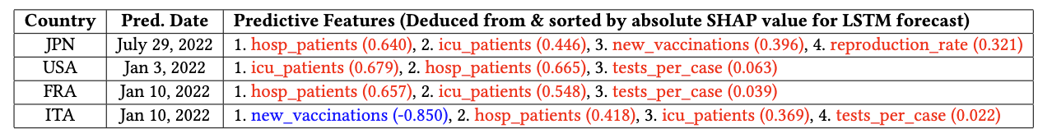
Local Explainability Analysis – Results
Predictive Local SHAP value Analysis for LSTM Model: 21-Day Peak COVID-19 Growth During Omicron Outbreak for every country (sorted in decreasing order of absolute SHAP value - red = positive SHAP, blue = negative SHAP)

Slide 21
Local Explainability Analysis - Discussion (Country-Specific Insights)
Japan (JPN): A counterintuitive positive SHAP value for new vaccinations indicates that increased vaccinations coincided with a surge in cases, perhaps due to the late arrival of the Omicron wave or a delay in vaccine effectiveness against this variant. Suggests the evolving efficacy of standard vaccines against new strains. Strong positive SHAP values for hospital and ICU patients.
United States (USA) and France (FRA): Strong positive SHAP values for hospital and ICU patients, reflecting the burden on healthcare systems.
Italy (ITA): Similar to the USA and France, hospital patients and ICU patients also have high SHAP values. Notably, new_vaccinations show a strong negative SHAP value, indicating the effective reduction in cases with increased vaccinations.

Slide 22
Local Explainability Analysis - Discussion (Cross-country Similarities + Differences)
Cross-Country Commonalities:
Hospital Patients and ICU Patients :
Revealed as consistently strong predictors with notably high POSITIVE SHAP values across all countries.
Validates our initial hypothesis based on time-series data analysis
Cross-Country Differences:
New Vaccinations:
Strong positive SHAP value in JPN, likely due to late surge and timing of Omicron variant.
Strong negative SHAP value in ITA, indicating possibly more effective vaccination campaigns in these countries
Reproduction Rate (Quantifies how quickly the virus is spreading)
Showed a positive SHAP value in JPN, indicating its significant role during the surge, but it was not among the top predictors; was not a good predictor in other countries

Slide 23
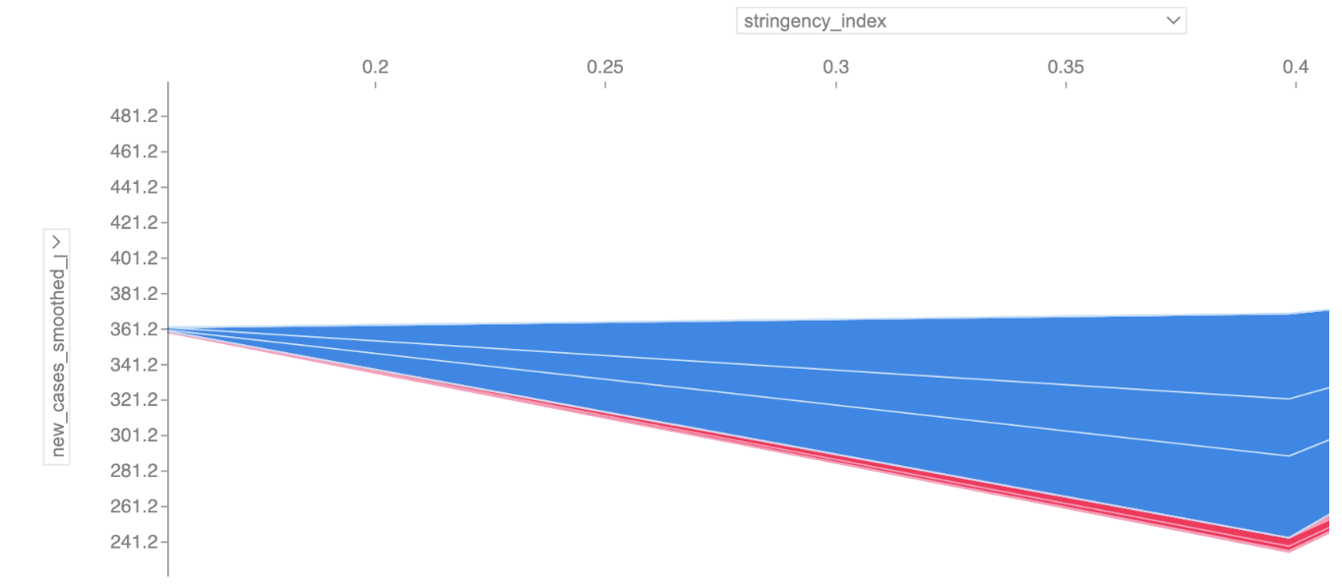
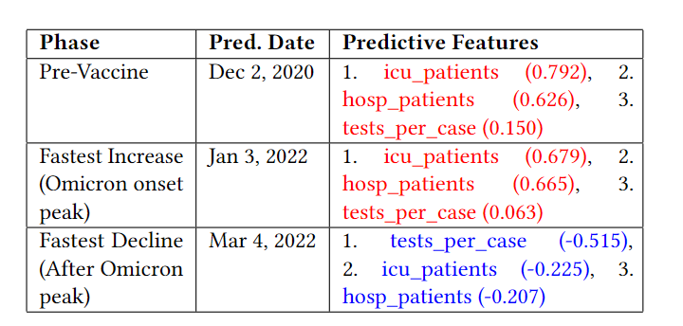
Cross-Phase Explainability Analysis (USA only)- Results
Table 4: Cross-Phase Analysis: Top predictive features based on SHAP values of contributions of features corresponding to LSTM model forecasts for different phases or periods of the pandemic for USA (sorted in decreasing order of absolute SHAP value - red = positive SHAP, blue = negative SHAP).
Figure 6: (APPENDIX) SHAP force plot illustrating the impact of the stringency index during the phase of fastest decline in COVID-19 cases (after first Omicron onset peak) in the USA. The plot shows the increase in stringency index correlating with the decrease in case counts.

Slide 24
Cross-Phase Explainability Analysis (USA only) - Discussion
Objective: Investigating variance in predictive features across different pandemic phases in the USA using local SHAP value analysis of LSTM forecasts.
Phases Analyzed:
Pre-Vaccine Peak Phase (2020): Key features - ICU Patients, Hospital Patients, Tests per Case.
Peak Phase During Omicron Outbreak (Q1 2022): Key features remained the same, indicating ongoing challenges in healthcare despite advancements.
Phase of Fastest Decline Post-Omicron Peak (2022): Key features - Tests per Case, ICU Patients, Hospital Patients (all with high but negative SHAP values).
Special Observation for the Decline Phase:
Notable change in stringency_index from 0.2 to 0.4 in the USA.
Increased stringency correlated with decreased case count forecast.
SHAP force plot for stringency_index (see Appendix Figure 6) demonstrates this impact.

Slide 25
Conclusion
Key Predictive Features:
Hospital patients and ICU patients are crucial for predicting COVID-19 case trends, consistently evident across different analyses.
Significance of Vaccination Data:
New vaccinations stand out as the second most predictive feature, underscoring the importance of vaccination efforts in pandemic dynamics, followed by stringency index and reproduction rate
Recommendations for Epidemic Management:
Emphasize the need for integrating hospital / ICU patient and vaccination data into public health policies for better epidemic preparedness and response
Study's Broader Contribution:
Reinforces the need for a comprehensive, data-driven approach in epidemic understanding and management.

